Slide 1

Mental Health Impact Analysis of International Students in Japan
An In-Depth Study Using SQL
By Shahla Liaquat

Slide 2
Objective
Analyze student mental health data.
Identify patterns and correlations.
Inform policies to improve student well-being.
Guide decision-making processes in educational institutions.

Slide 3
Dataset
Attributes are :
Gender
Age
Course
Year of Study
GPA
Attendance
Mental Health Issue (Yes/No)
Counseling Service Used (Yes/No)
Hours of Sleep
Physical Activity (hours/week)

Slide 4
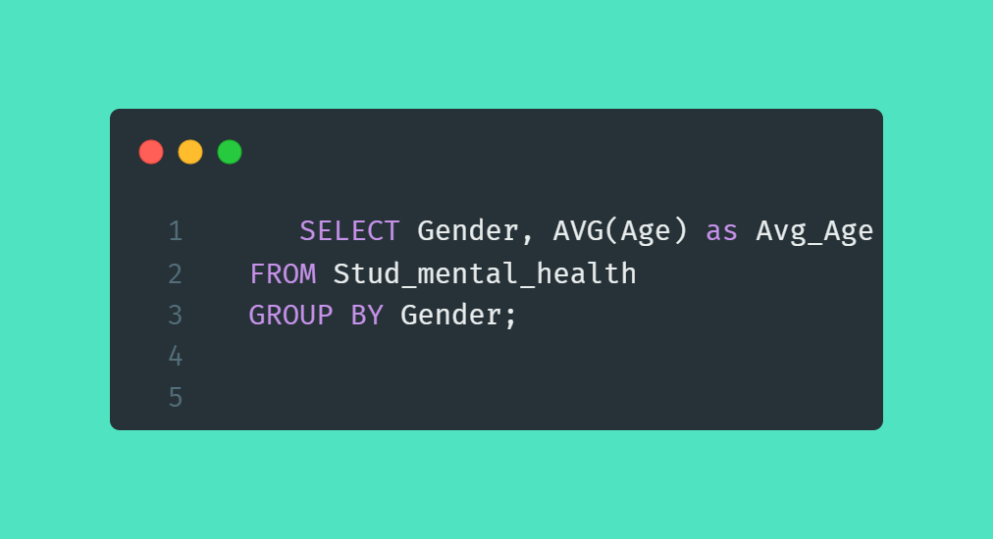
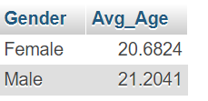
What is the average age of students by gender

Slide 5
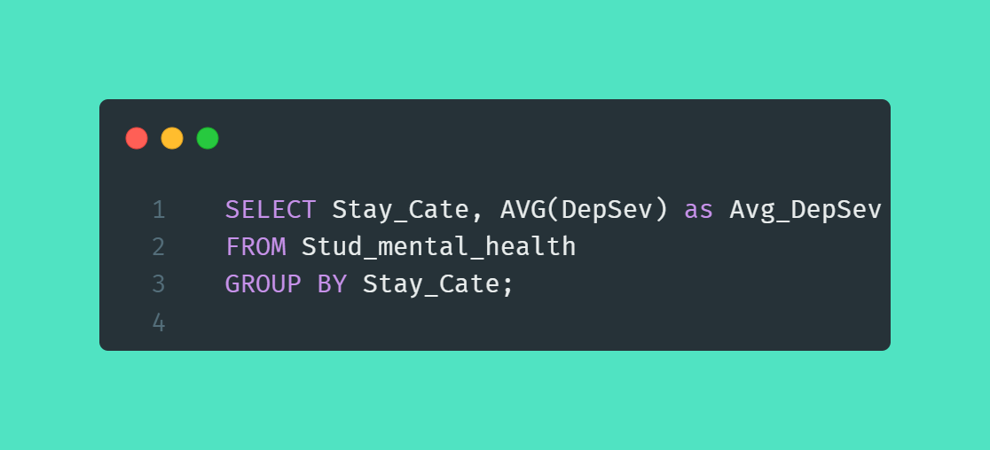
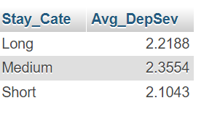
Average severity of depression based on the length of stay in Japan?

Slide 6
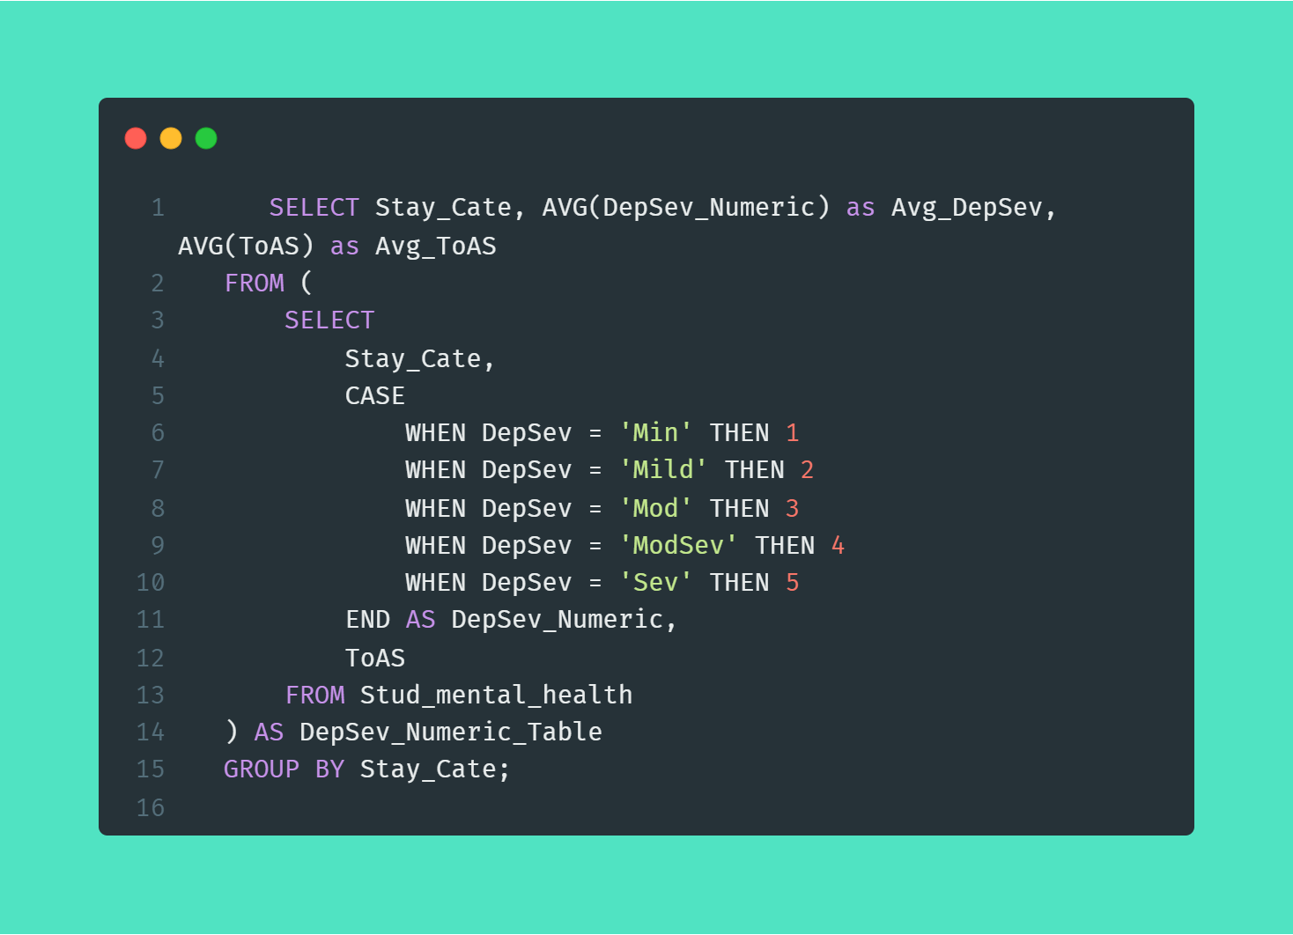
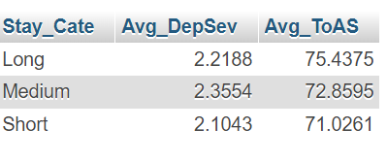
Is there a difference in mental health issues based on the length of stay in Japan (Stay_Cate)?

Slide 7
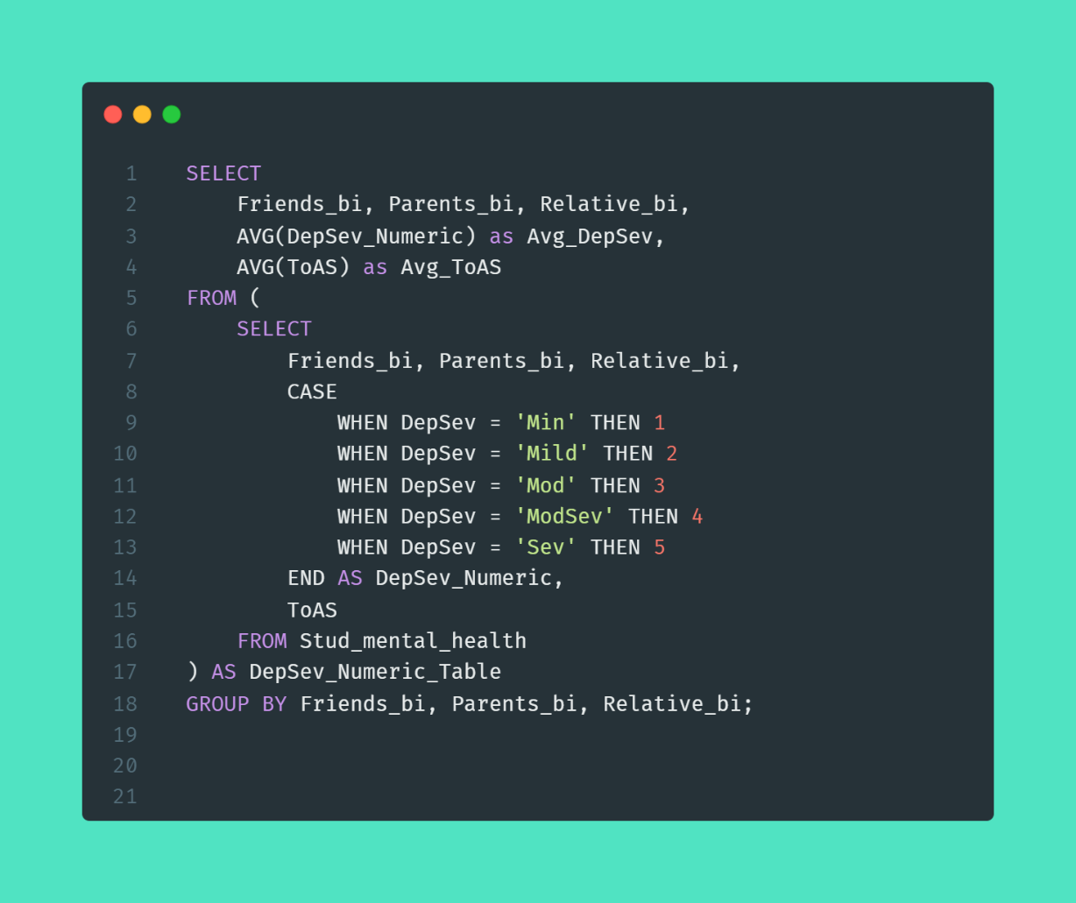
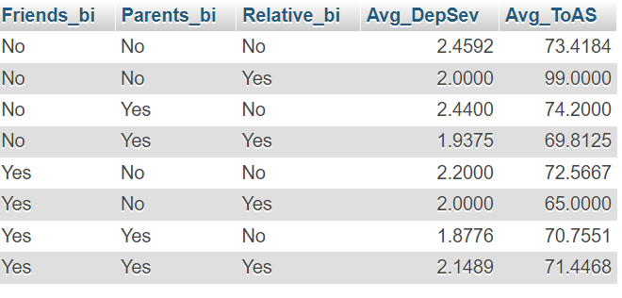
How does having a support system (friends, parents, relatives) influence the severity of depression and anxiety?

Slide 8
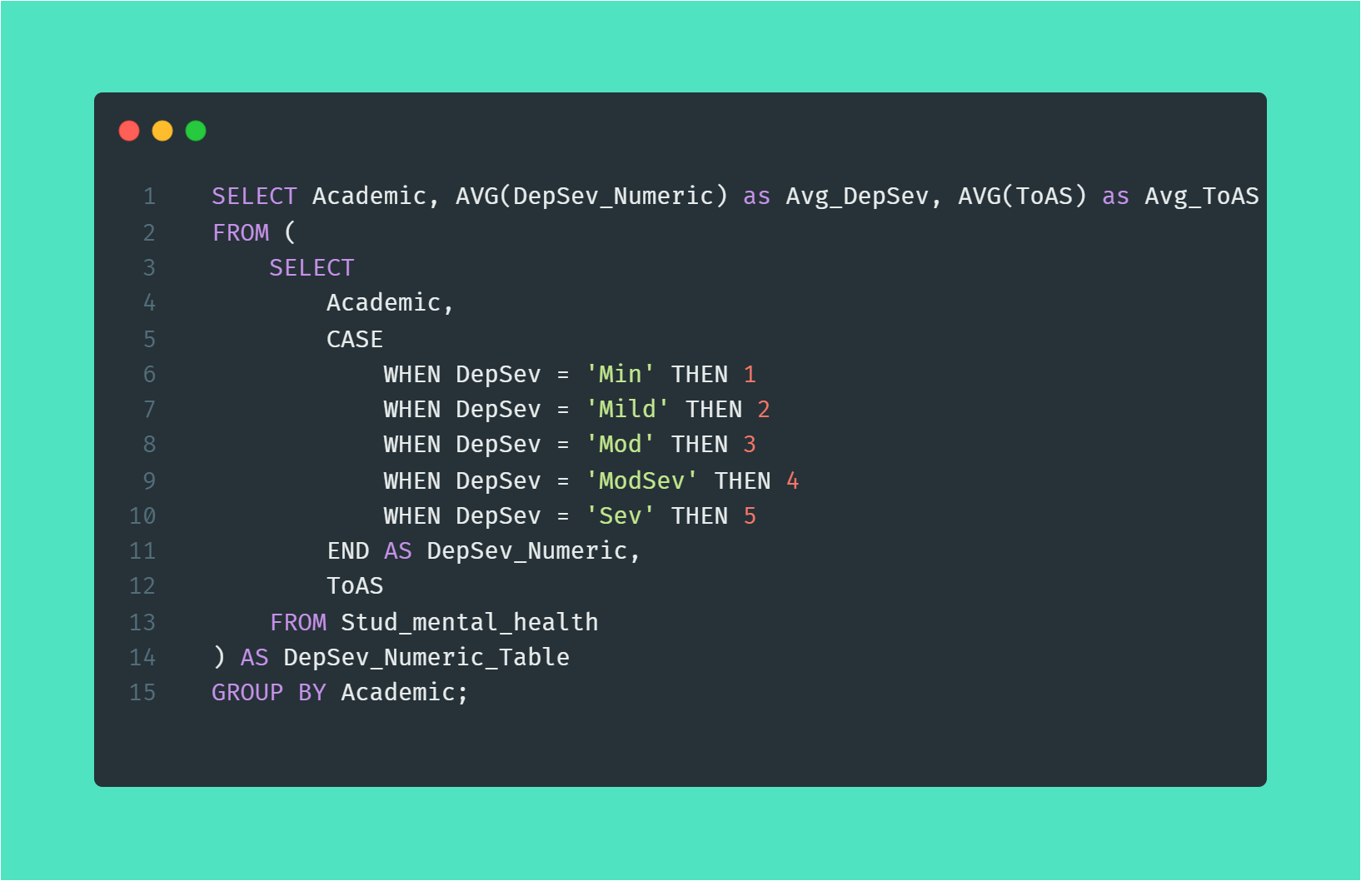
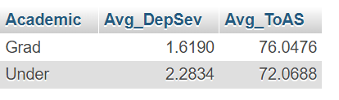
Is there a correlation between the academic level (undergrad vs. grad) and mental health issues?

Slide 9
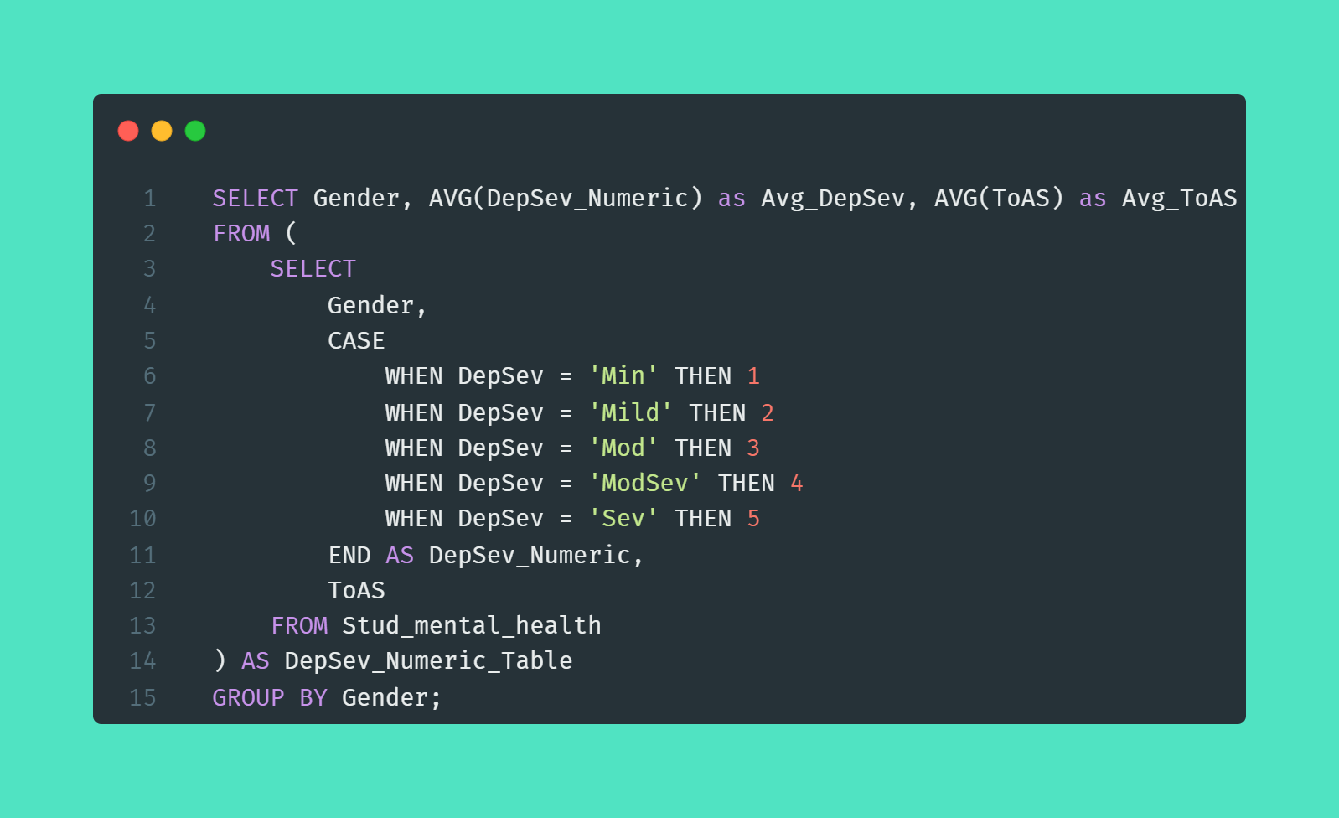
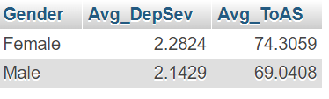
How does gender affect the severity of depression and anxiety?

Slide 10
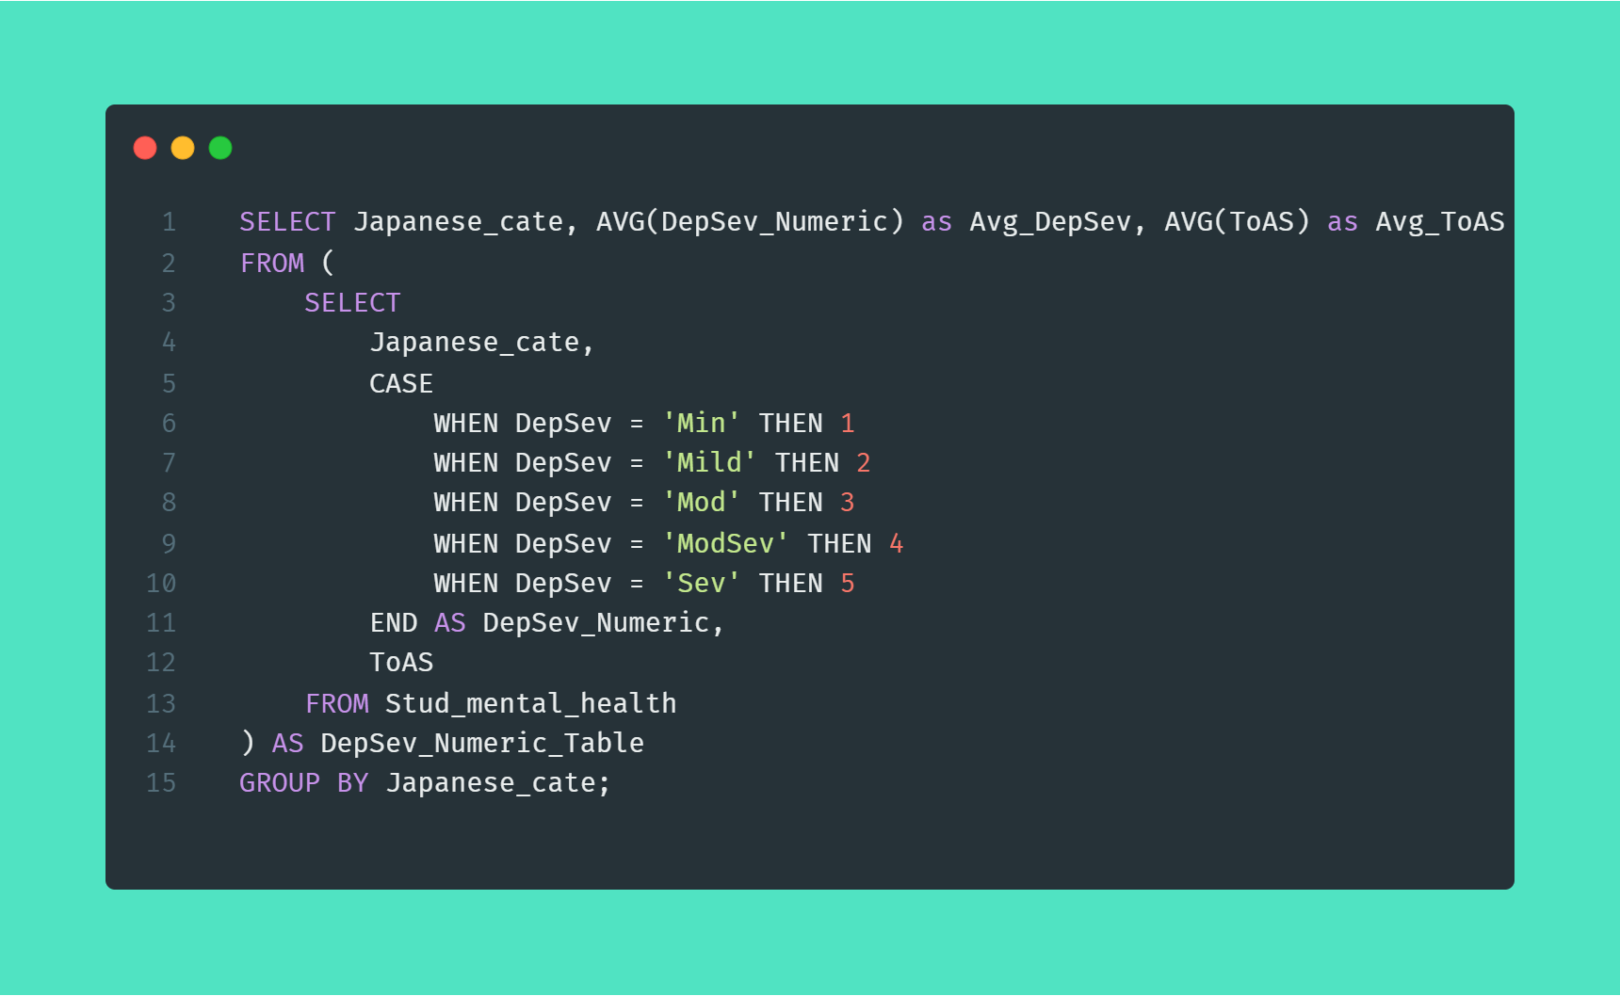
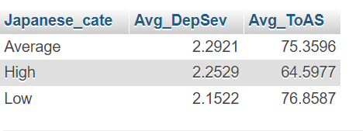
What is the impact of Japanese language proficiency on the severity of depression and anxiety?

Slide 11
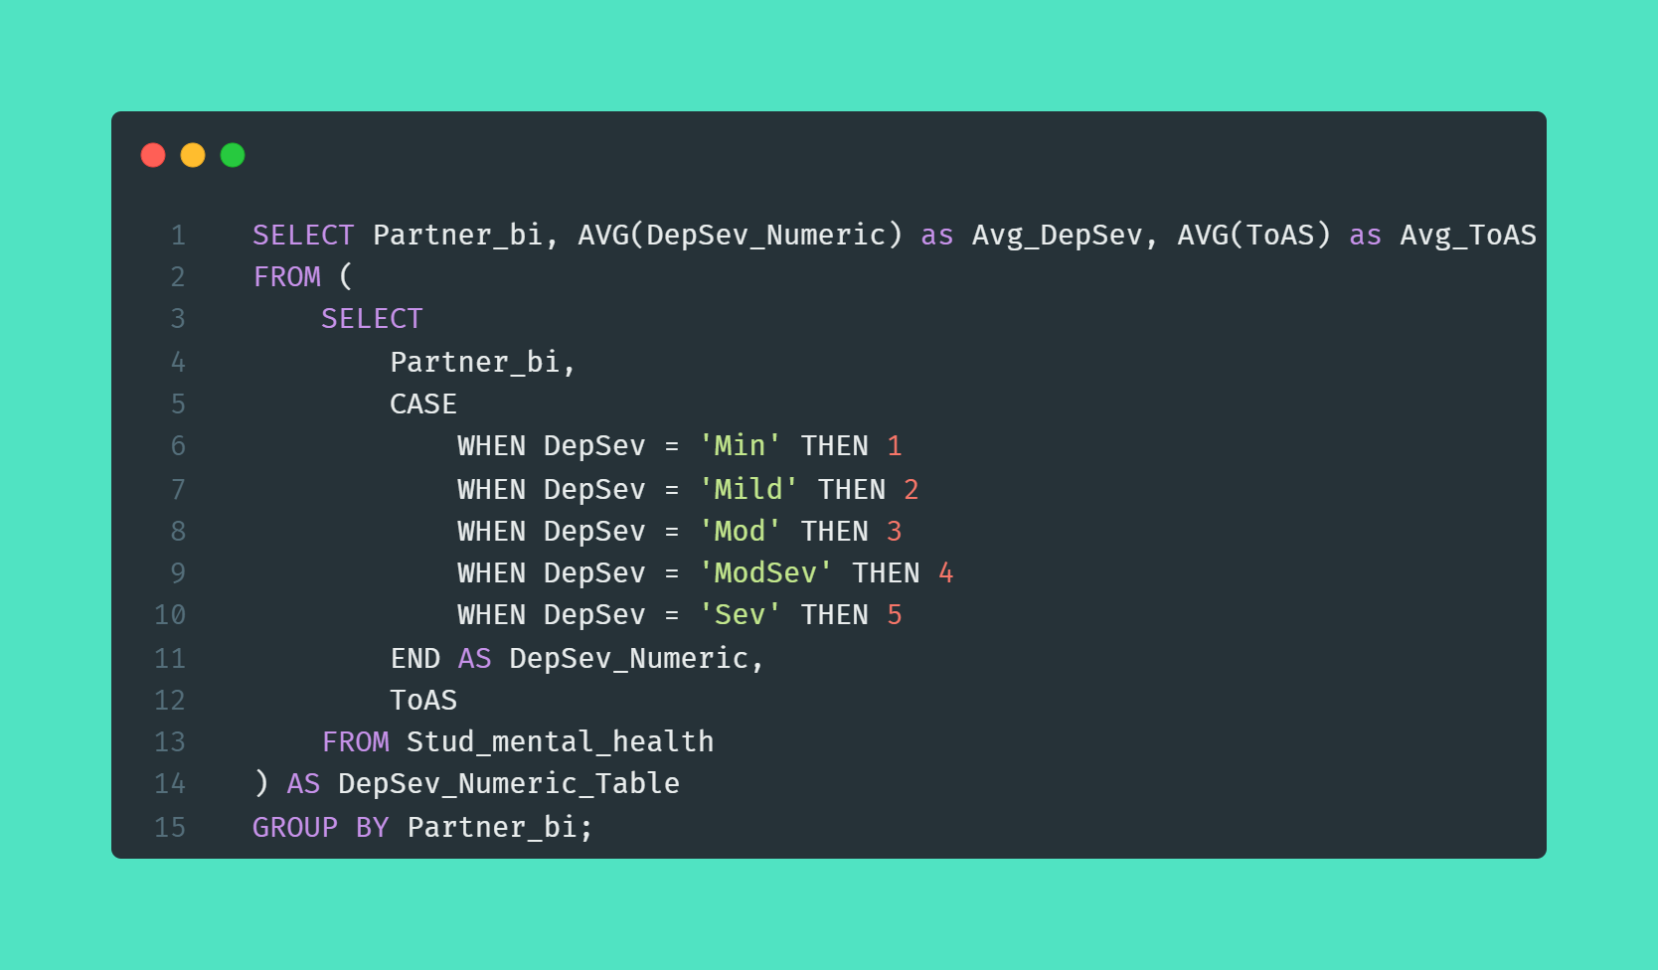
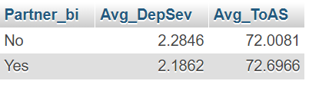
Does the relationship status (e.g., having a partner) influence mental health issues

Slide 12
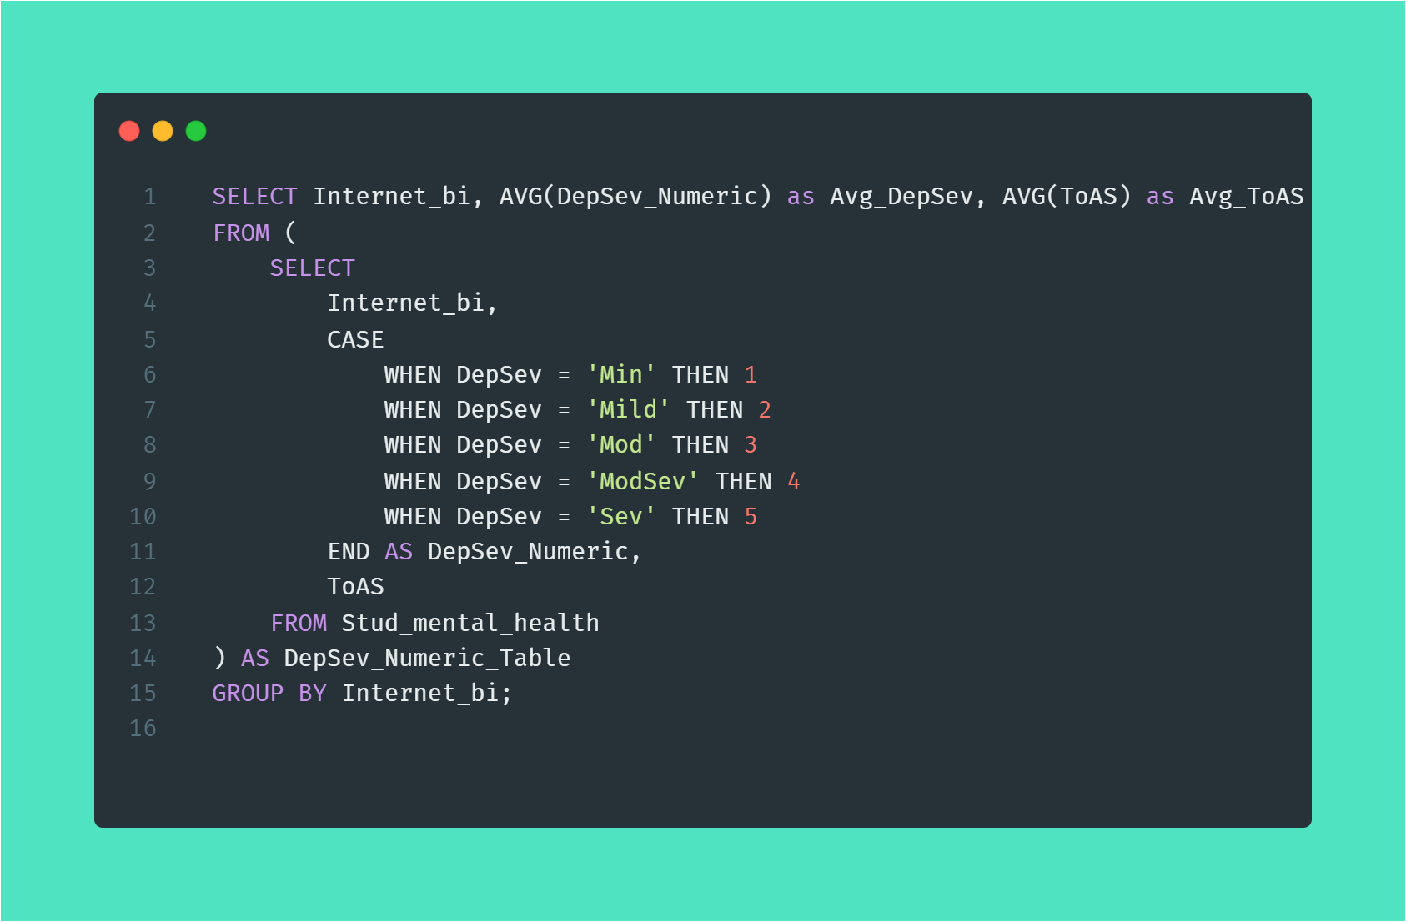
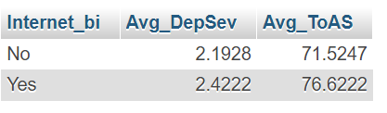
How does the usage of the internet influence the severity of depression and anxiety?

